Slide 1
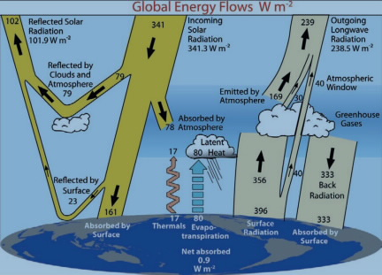
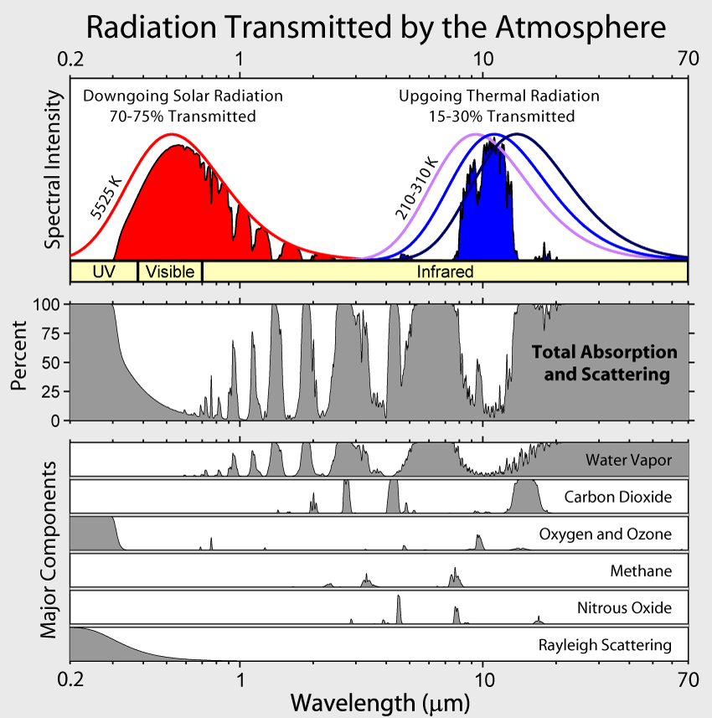
Spectral (wavelength-dependent) properties of the atmosphere

Slide 2
Spectral (wavelength-dependent) properties of the atmosphere

Slide 3
Spectral (wavelength-dependent) properties of the atmosphere

Slide 4
Spectral (wavelength-dependent) properties of the atmosphere

Slide 5
Spectral (wavelength-dependent) properties of the atmosphere

Slide 6
Spectral (wavelength-dependent) properties of the atmosphere

Slide 7
Total atmospheric absorption of light is due to the gases in it
Water vapor’s contribution to the total absorption by the atmosphere

Slide 8
Total atmospheric absorption of light is due to the gases in it
CO₂’s contribution to the total absorption by the atmosphere

Slide 9
Total atmospheric absorption of light is due to the gases in it
Working in pairs:
Which gases seem to be responsible for that 78 W/m² in the shortwave?
Which gases seem to be responsible for that 356 W/m² in the shortwave?

Slide 10
Total atmospheric absorption of light is due to the gases in it
Our next task:
What’s going on at the molecular level?
Answering these questions:
Provides a fundamental understanding of the chemical drivers of greenhouse warming
Is also fun (because Spartan)

Slide 11
Last week: light accelerates opposite charges in opposite directions
-
+

Slide 12
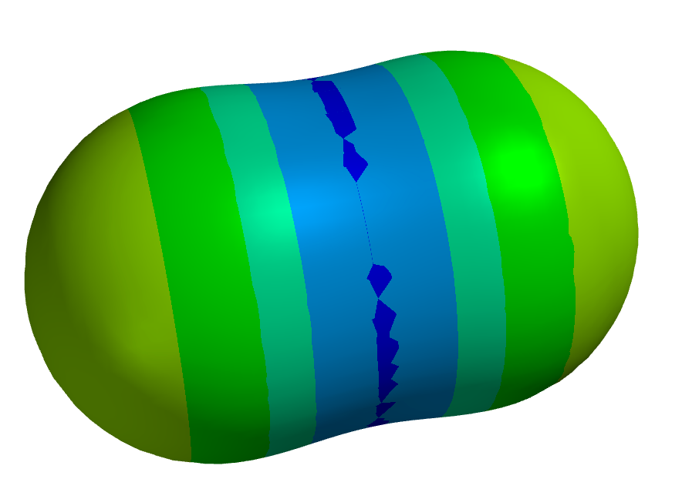
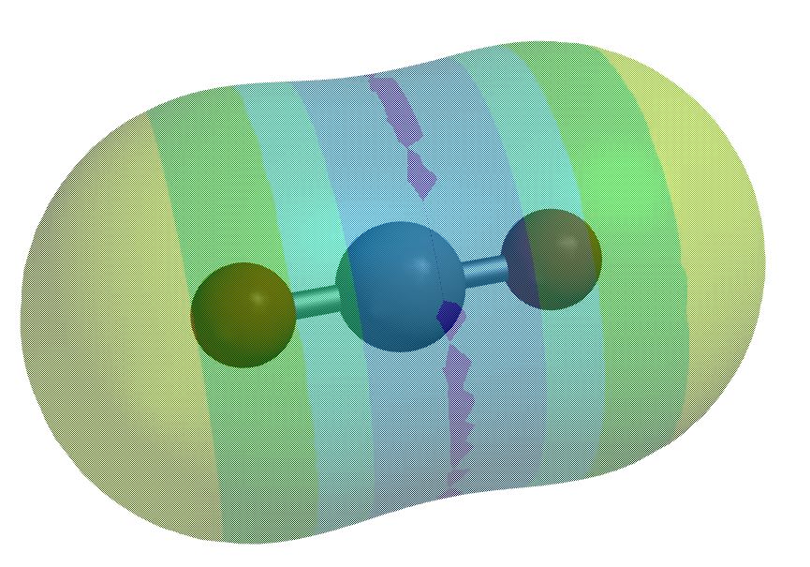
Molecular polarity
Even if a molecule has no net charge, many still have an internal charge imbalance.
Warm colors (red/orange/yellow) mean excess negative charge (build-up of electrons on that part of the surface)
Cool colors (blue/turquoise) mean excess positive charge (deficit of electrons on that part of the surface)

Slide 13
Molecular polarity
These excess charges actually go deeper than the surface – we say that the atoms themselves have partial charges (+ or -)
-
+
-

Slide 14
So what’s going to happen here?
-
+
-

Slide 15
Right now, light bends the CO₂ this way
-
+
-

Slide 16
And now, this way
-
-
+
-

Slide 17
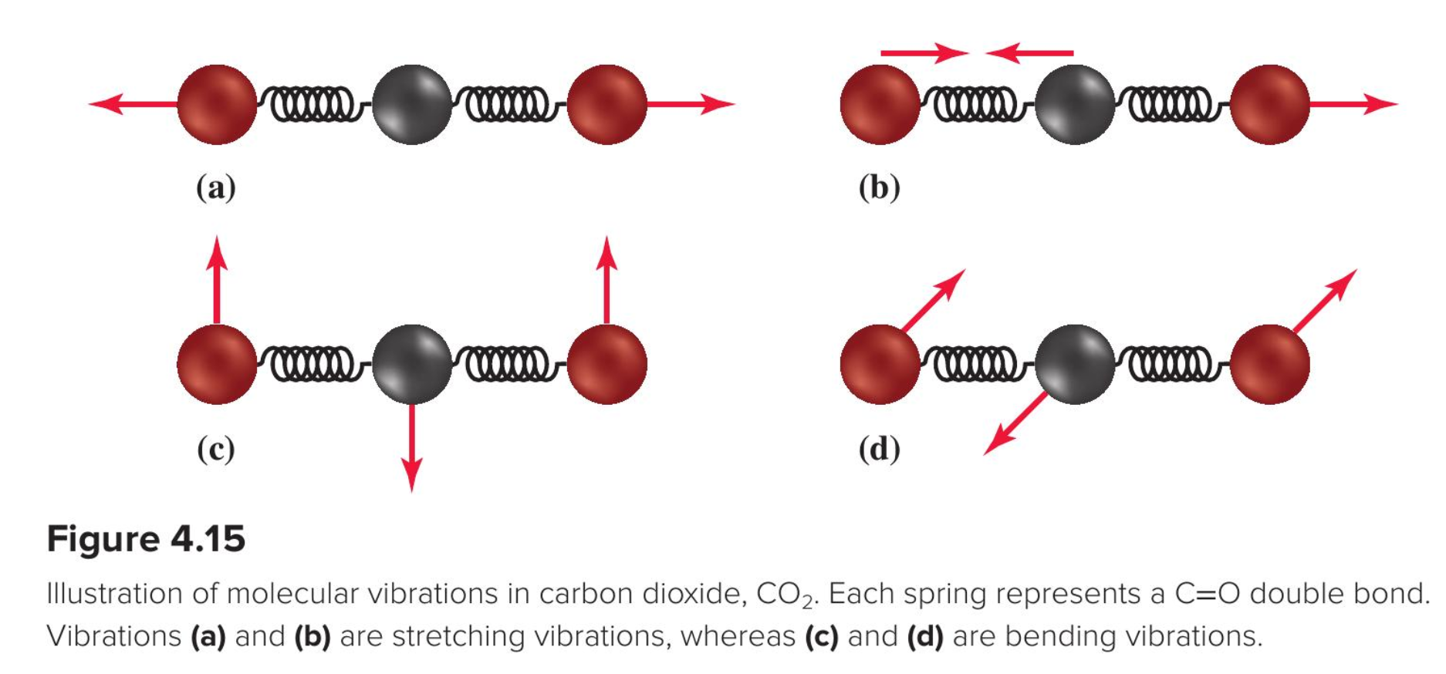
Bending mode of CO₂
Figure 4.5 in your text

Slide 18
Bending mode of CO₂
Figure 4.5 in your text
Now we’re going to make all this happen in Spartan

Slide 19
Examining the IR activity of CO2
Make carbon dioxide
Solve the electronic structure
Notice the partial charges (also called atomic charges)
Construct an electrostatic potential map (EPM)
Get an IR spectrum
Look at the vibrational motion
Identify any IR-active vibrational modes

Slide 20
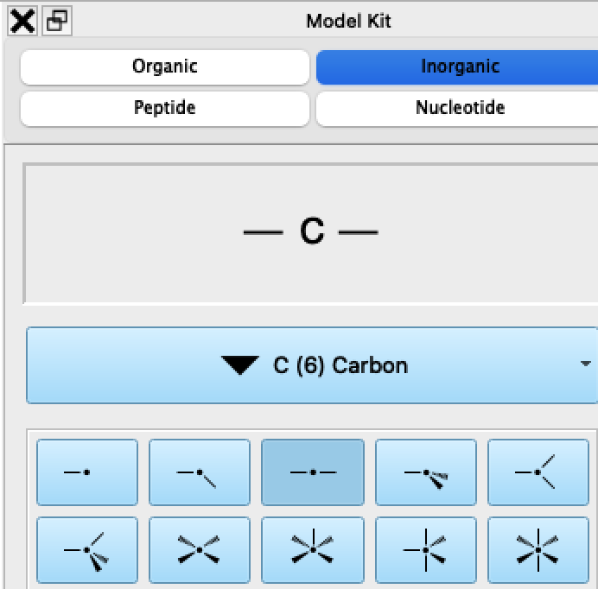
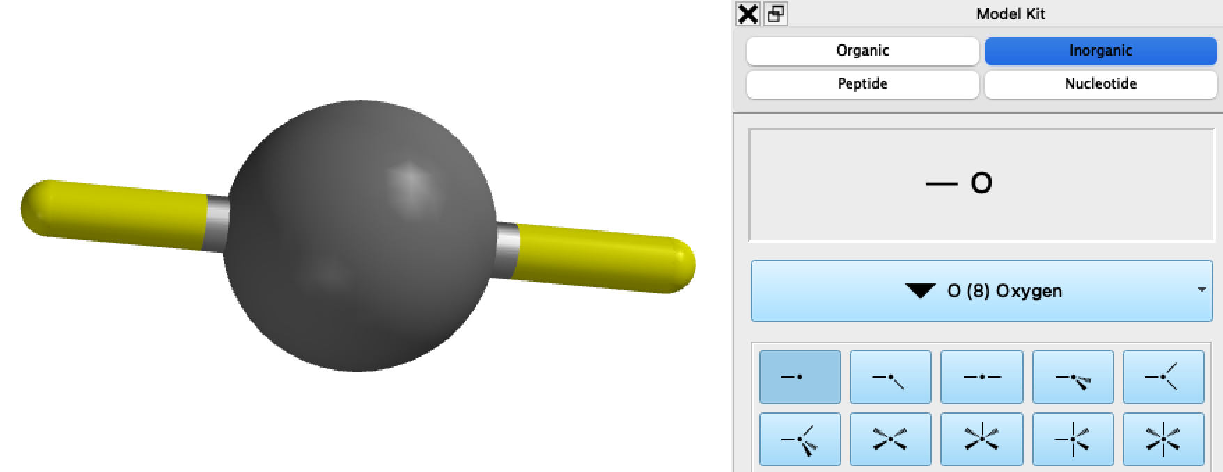
Making CO₂ in Spartan
First make carbon …
... then add oxygens

Slide 21
Examining the IR activity of CO2
Make carbon dioxide
Solve the electronic structure
Notice the partial charges (also called atomic charges)
Construct an electrostatic potential map (EPM)
Get an IR spectrum
Look at the vibrational motion
Identify any IR-active vibrational modes

Slide 22
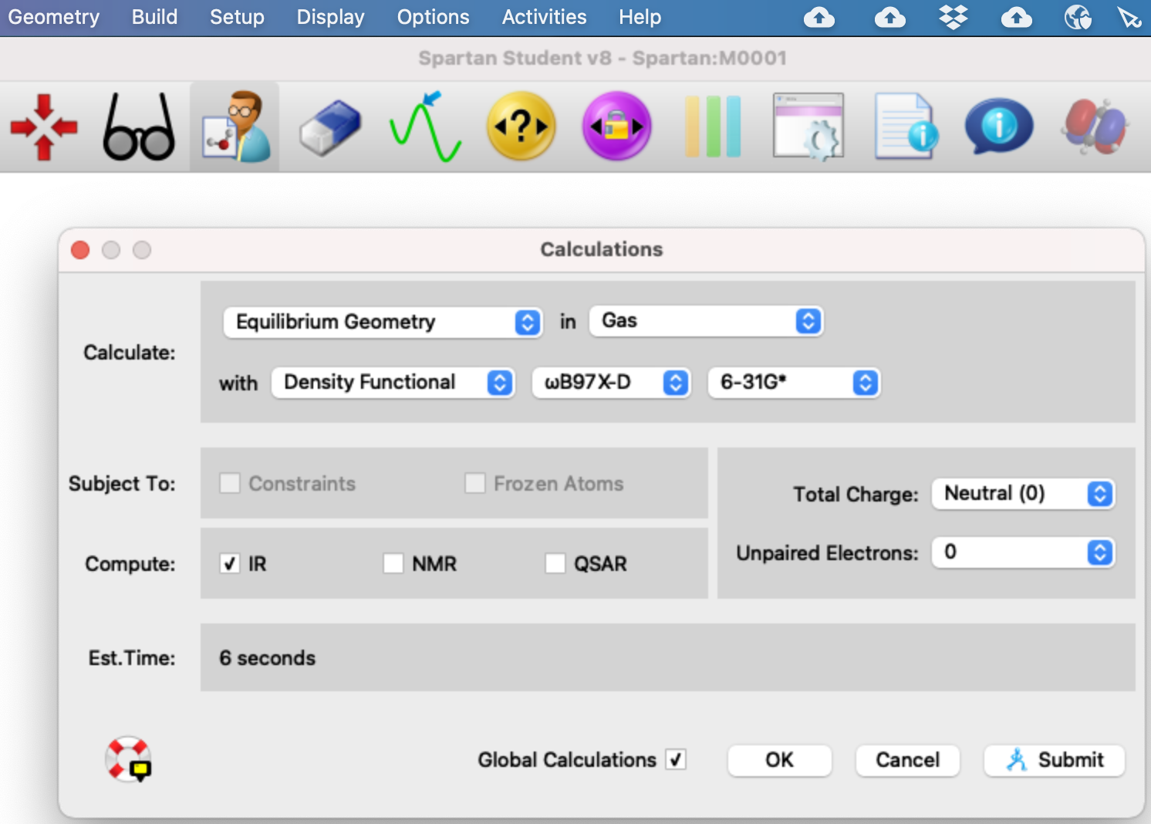
Solve the electronic structure (and enable IR)

Slide 23
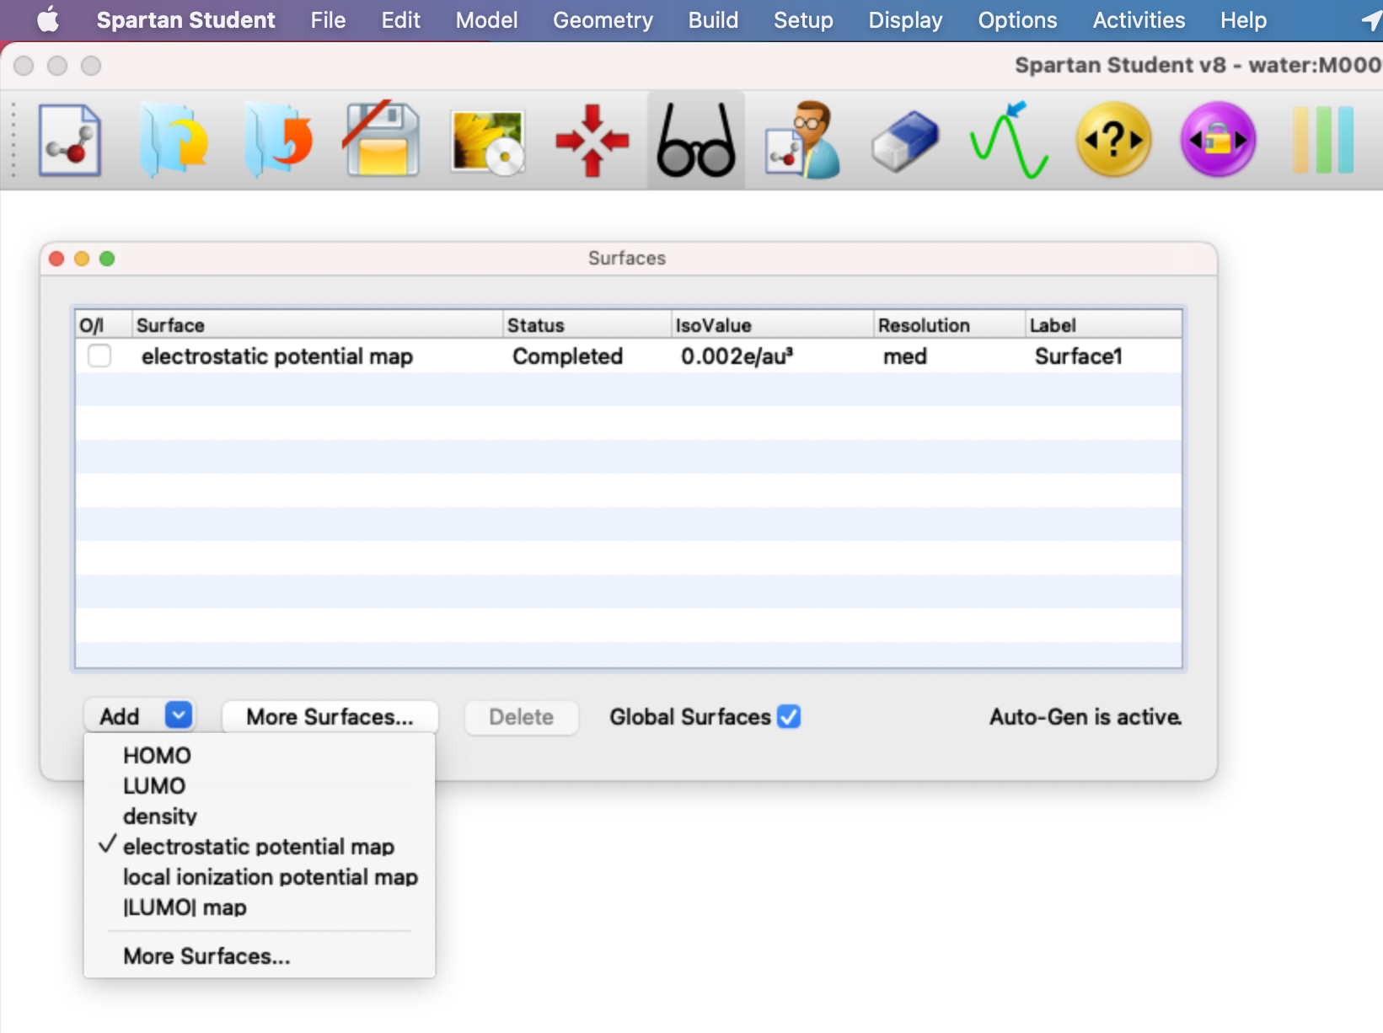
Construct an electrostatic potential map (EPM)
Recall:
Warm colors (red/orange/yellow) mean excess negative charge (build-up of electrons on that part of the surface)
Cool colors (blue/turquoise) mean excess positive charge (deficit of electrons on that part of the surface)

Slide 24
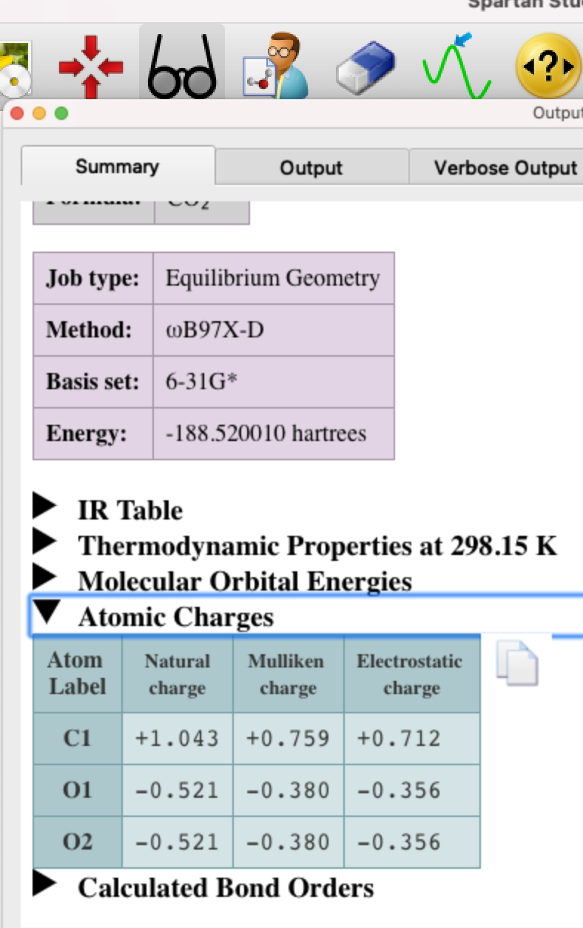
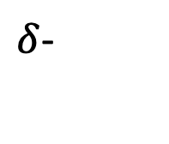
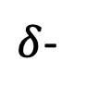
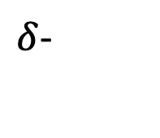
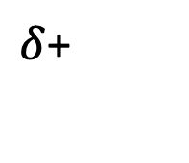
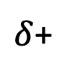
Notice the partial charges (also called atomic charges)
$δ$+
$δ$-
$δ$-
$δ$+
$δ$-

Slide 25
Examining the IR activity of CO2
Make carbon dioxide
Solve the electronic structure
Notice the partial charges (also called atomic charges)
Construct an electrostatic potential map (EPM)
Get an IR spectrum
Look at the vibrational motion
Identify any IR-active vibrational modes

Slide 26
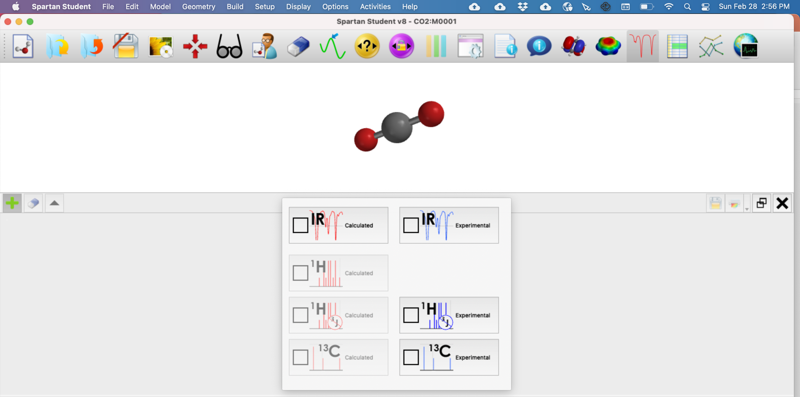
Selecting the IR spectrum
X

